Slide 1
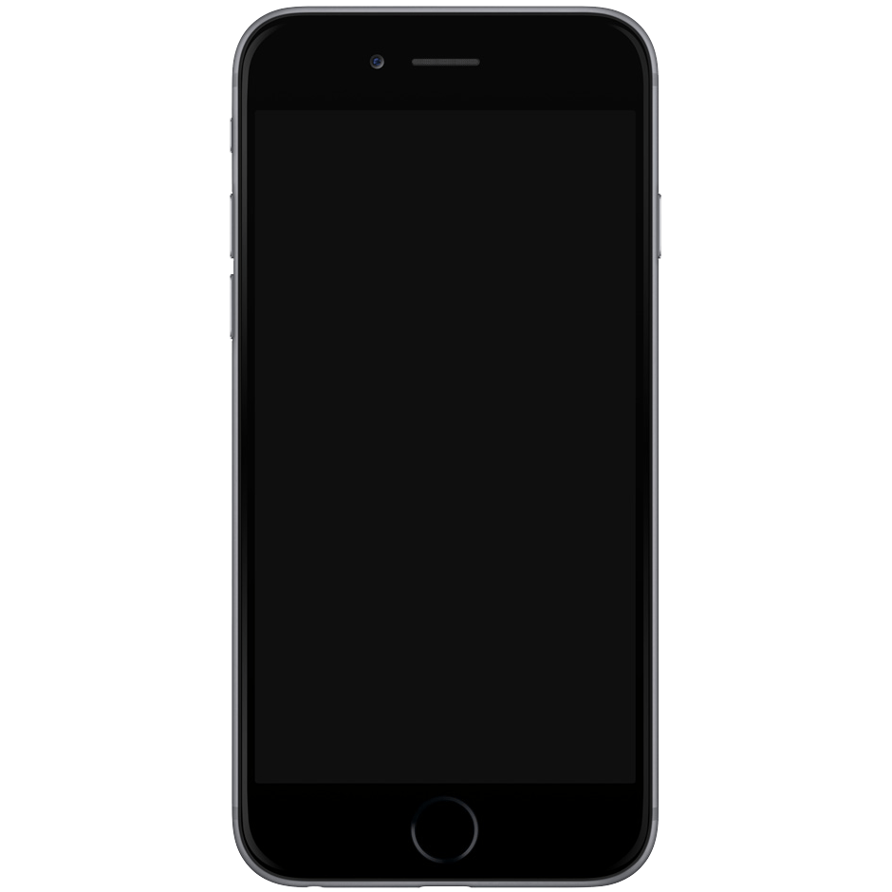
mobile_dev
flutter basics

Slide 2



Slide 3
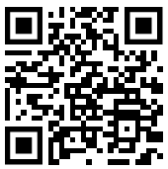
Installing flutter
docs.flutter.dev/get-started/install

Slide 4
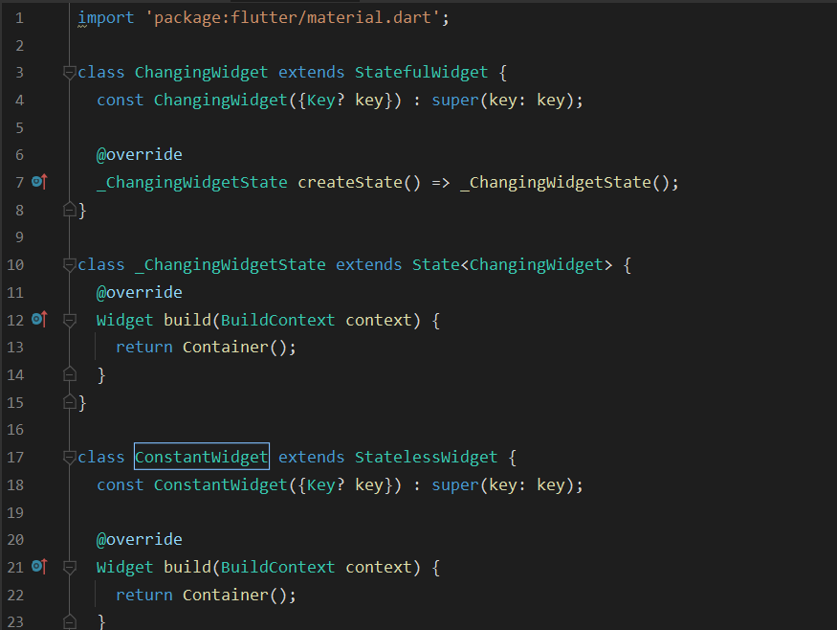
Coding time!

